Slide 1
CLASSIFICATION OF IRIS FLOWER USING MACHINE LEARNING
Komal Ginwal
10449929

Slide 2
Table of Contents
About Data
Libraries
Summarize the dataset.
Data Visualization
Evaluation of Algorithm
Result

Slide 3
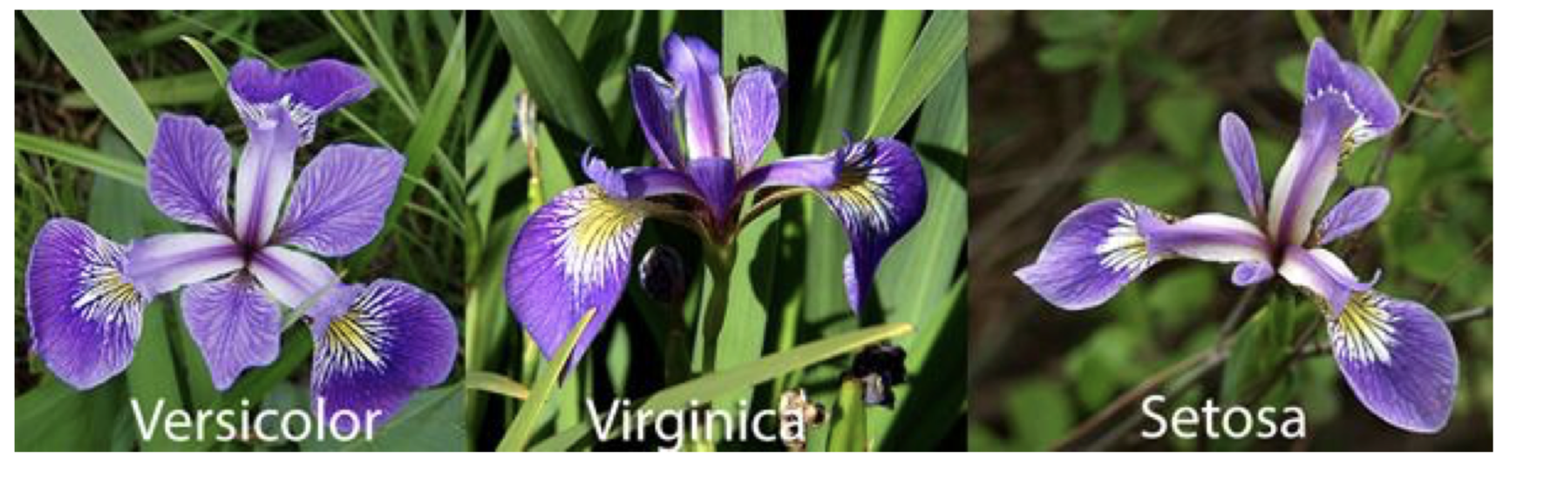
Abstract
Classification of IRIS data set would be discovering patterns from examining petal and sepal size of the IRIS flower and how the prediction was made from analyzing the pattern to from the class of IRIS flower. In this paper we train the machine learning model with data and when unseen data is discovered the predictive model predicts the species using what it has been learnt from the trained data.

Slide 4
Problem Definition
To design and implement the Classification of Iris Flower species using machine learning using Python and the tool Scikit-Learn.

Slide 5
About Data
The data set contains 3 classes of 50 instances each, total 150 instances, where each class refers to a type of Iris plant. One class is linearly separable from the other 2 and the latter are not linearly separable from each other.
Predicting attribute: Class of Iris plant.
Associated Task | Classification
Data Set Characteristics | Multivariate
Attribute Characteristics | Real
Number of Instances | 150
Number of Attributes | 4
Missing Values? | No
Area | Life

Slide 6
Evaluation of Algorithms
Creation of validation dataset : We will split the loaded dataset into two, 80% of which we will use to train, evaluate and select among our models, and 20% that we will hold back as a validation dataset.
2. Test Harness : Stratified 10-fold cross validation to estimate model accuracy.
This will split our dataset into 10 parts, train on 9 and test on 1 and repeat for all combinations of train-test splits.

Slide 7
3. Build Model
We'll evaluate these 6 algorithms:
Logistic Regression (LR)
Linear Discriminate Analysis (LDA)
K-Nearest Neighbors (KNN)
Classification and Regression Trees (CRT)
Guassian Naive Bayes (GNN)
Support Vector Machine (SVM)
This is a good mixture of simple linear (LR and LDA), nonlinear (KNN, CRT, NB and SVM) algorithms. We reset the random number seed before each run to ensure that the evaluation of each algorithm is performed using exactly the same data splits. It ensures the results are directly comparable.

Slide 8
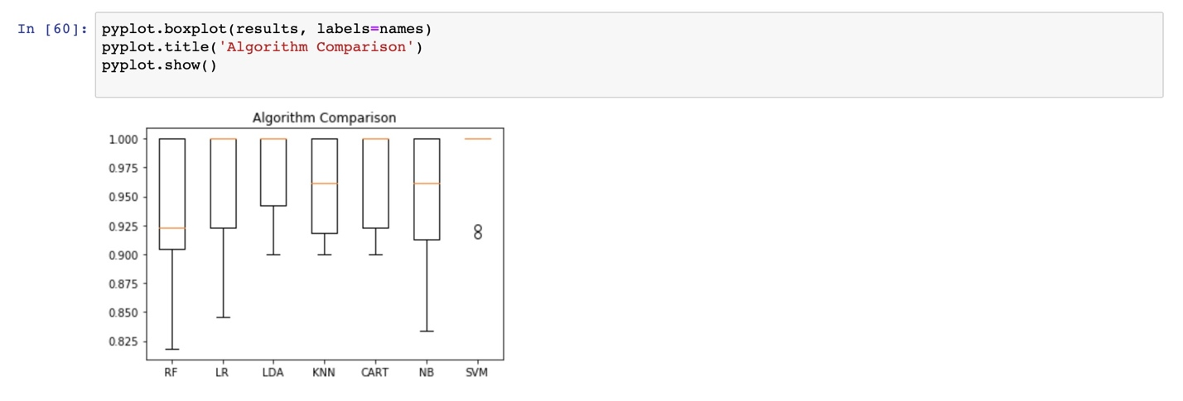
4 Select Best Model
We now have 6 models and accuracy estimations for each. We need to compare the models to each other and select the most accurate.
Running the example above, we get the following raw results:
Box and Whisker Plot Comparing Machine Learning Algorithms on the Iris Flowers Dataset

Slide 9
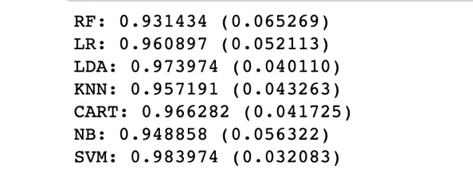
Result
We can make predictions on the validation dataset by fitting the entire model on training dataset
The results in the previous section suggest that the SVM was perhaps the most accurate model.

Slide 10
KOMAL GINWAL
kginwal@stevens.edu

